Slide 1
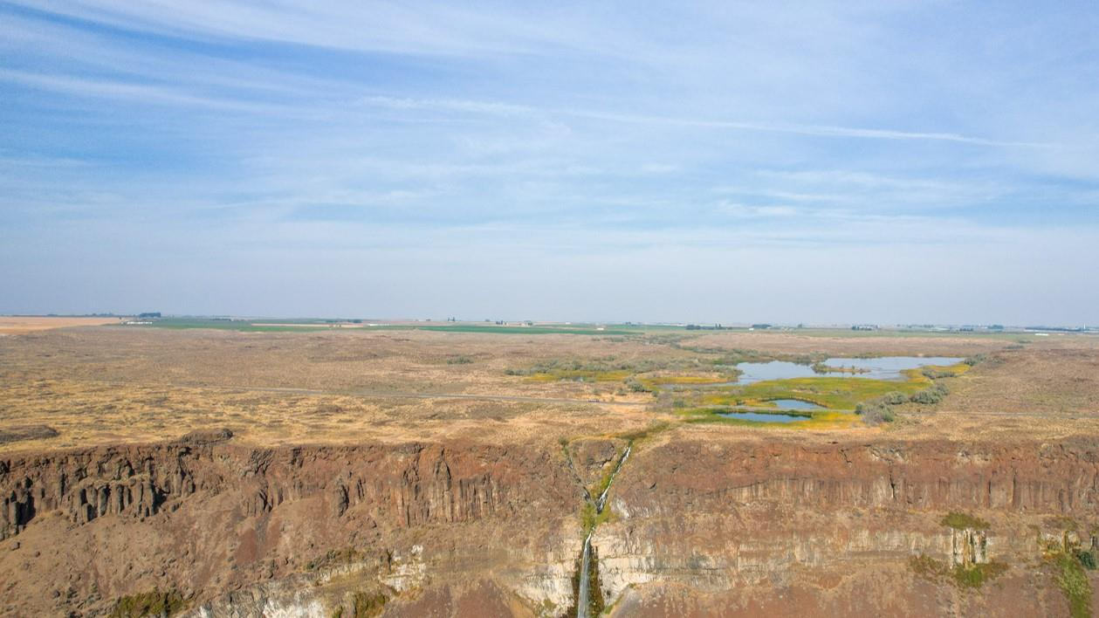


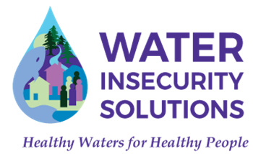
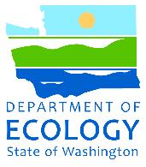


Collaborative Approaches to Groundwater Sustainability in the Columbia Basin
AGWT Northwest Groundwater Conference, March 17, 2026
Brean Nieman, Lincoln County Conservation District
Sarah Weeks, LHG, Landau Associates

Slide 2
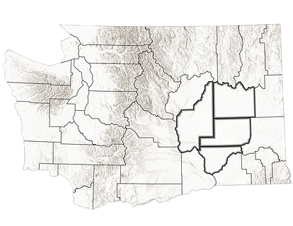
Presentation Outline
Project Introduction – Mid-Columbia Basin Drought Plan
Project Team
Regional Overview
  Community
  Climate
  Water Availability
  Groundwater Declines
  Drought History
Collaborative Approach
  Formation of Columbia Basin Sustainable Water Coalition
  Broadening the Coalition
  Community Engagement Plan
  Overburdened Communities
  Engagement Goals & Strategies
Drought Risks & Mitigation Projects
Questions/Discussion
Mid-Columbia Basin
Notes:
Good morning and welcome. My name is Brean Nieman, and I’m the Lead Grant Coordinator with the Lincoln County Conservation District. I’m joined today by Sarah Weeks from Landau Associates, who brings expertise in groundwater systems and understanding how aquifers respond to pumping and long-term water use.
Today we’ll be sharing an overview of our current grant-funded project, the Mid-Columbia Basin Drought Preparedness Plan, which is currently in the middle stages of development. The goal of this effort is to strengthen drought preparedness across the region by supporting water purveyors, agricultural producers, and the long-term sustainability of our groundwater and water resources.
To begin, we’ll provide a brief regional overview, including community and climate considerations, water availability, groundwater trends, and some of the drought history that has shaped planning efforts in this region. We’ll also touch on the collaborative approach behind this work, including the role of the Columbia Basin Sustainable Water Coalition and the importance of broad community engagement.
Many of you are already very familiar with these topics, so our goal today is to provide a brief overview of the project and some of the drought risks and mitigation strategies being explored. and then open the floor for questions and discussion at the end of the presentation.

Slide 3
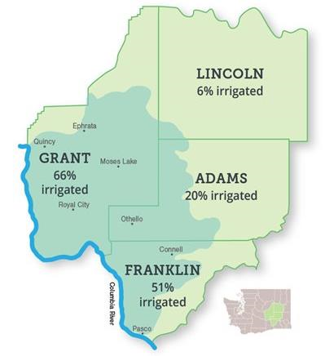
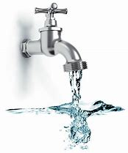
Project Introduction
Mid-Columbia Basin Drought Plan
Where? FLAG Counties
When? Feb 2025 – Feb 2027
Why? Increase drought preparedness, resiliency, and water supply security
Goals:
  ID drought risks and drought mitigation projects
  Help FLAG communities secure funding for project implementation
Funding: Washington Ecology Water Resources, Drought Planning and Preparedness Grant
80% of the Population relies on groundwater for drinking water
Notes:
As I referred to a few minutes ago our grant project is the Mid-Columbia Basin Drought Preparedness Plan, which focuses on the FLAG counties: Franklin, Lincoln, Adams and Grant.
The project began in February 2025 and will be completed by February 2027.
The purpose of this effort, as outlined by Ecology in 2023, is to incentivize and support increased drought preparedness, resiliency, and water supply security, particularly for local and vulnerable communities.
Our primary goals are to:
Identify drought risks and potential mitigation projects, and
Assist FLAG communities in securing funding to implement those projects.
This work is funded through Ecology’s Water Resources Drought Planning and Preparedness Grant.
The Mid-Columbia Basin is a wide, arid lowland in south-central Washington. The planning area is largely rural, and the dominant land use is commercial agriculture. Irrigated agriculture and public water supply systems depend on local surface water delivered by the Columbia Basin Project and groundwater pumping from the basalt aquifer.
It is also important to note that approximately 80% of the population in this region relies on groundwater for drinking water, which emphasizes the importance of proactive drought planning.”

Slide 4
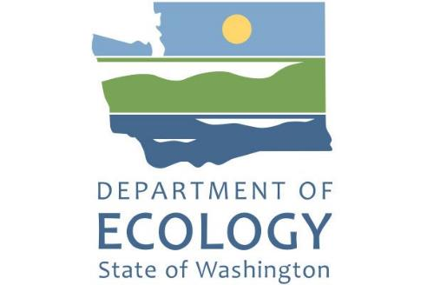



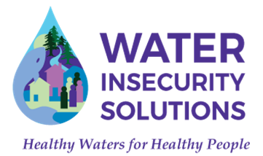
Project Team
Funding Agency
Project Lead
Project Support
4
Notes:
The Lincoln County Conservation District, together with the Columbia Basin Sustainable Water Coalition, are leading this drought preparedness grant. I want to acknowledge the Coalition for its strong leadership in bringing diverse stakeholders together to address our region’s declining groundwater supplies. Their focus is on developing locally driven recommendations that guide water management and policy, ensuring that resources are directed toward sustainable solutions for both today’s challenges and future needs.
We’ve also been fortunate to work with strong technical partners—Landau Associates , GeoEngineers and Water Insecurity Solutions—who have helped gather data, draft key sections, and evaluate drought preparedness strategies that can work across different types of water users.
Our goal is to engage a diverse range of individuals and organizations. Their input will help shape and strengthen the final Drought Preparedness Plan, ensuring it reflects a broad spectrum of perspectives and needs.
A quick fun fact for those who may not know: conservation districts were created following the severe drought and crop failures of the 1930s that led to the Dust Bowl. In 1937, the federal government encouraged states to pass laws allowing locally led conservation districts to form, giving farmers and landowners a way to work together to conserve soil and water resources.

Slide 5
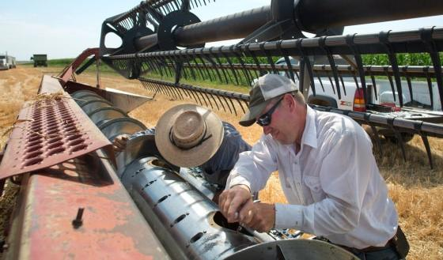
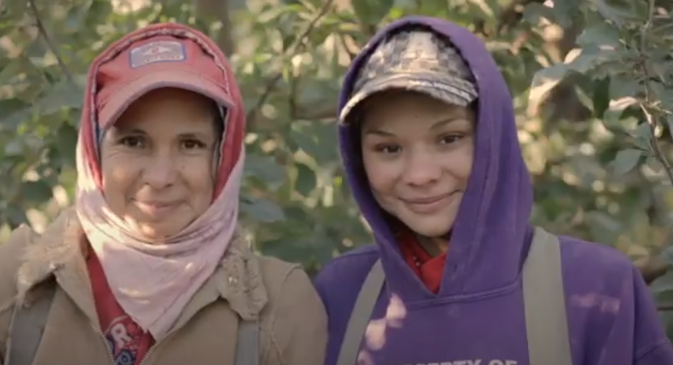

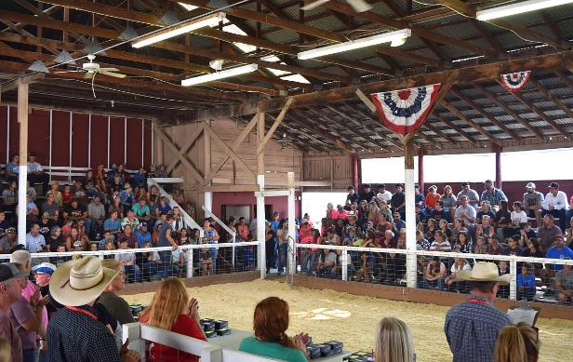
Community
Rural, Agricultural
Farmers and farm workers (1 in 5 jobs tied to Ag)
Large Hispanic + Latino community
Native American community
Relative to WA State averages: - younger, lower household incomes
Notes:
This region is largely rural and heavily rooted in agriculture. Farming plays a major role in the local economy and in daily life for many residents.
About one in five jobs in the area is tied to agriculture, including farmers, farm workers, food processing, and supporting industries.
The communities here are also culturally diverse, with a large Hispanic and Latino population that plays a significant role in both the agricultural workforce and the broader community. This makes it especially important to use collaborative communication approaches that engage people through the appropriate channels and in the languages most commonly spoken in the community.
There is also an important Native American presence, particularly through nearby Tribal communities that have longstanding cultural and historical connections to the land and water resources in this region.
Compared to overall Washington State averages, the population in this area tends to be younger and has lower median household incomes, which can influence how communities experience and respond to challenges like drought, economic shifts, and resource access.

Slide 6
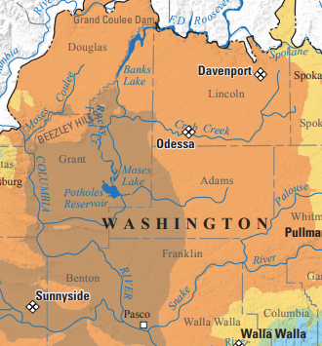
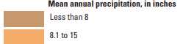
Climate
Annual Precipitation
Semi-arid climate
Low precipitation
Intent of “the Plan”
  Identify factors that make local communities vulnerable to drought
  Assess current level of drought preparedness in the region
  Water supply-side and water demand-side projects and actions to decrease region’s drought vulnerability
  Costs and timing for those projects and actions, and identify potential funding sources
Notes:
Historically, this region served as hunting and fishing grounds for Tribal communities, though it remained sparsely populated because of the dry climate and limited water resources.
Over time, the land transitioned into cattle ranching, and later into dryland wheat farming, which became a major agricultural activity in the area.
In the mid-20th century, the construction of dams and irrigation canals transformed the region. With access to irrigation water, roughly half of the landscape shifted to irrigated agriculture, allowing growers to produce higher-value crops.
To give a sense of just how dry this region is, Moses Lake actually receives less annual rainfall than Phoenix—a comparison shared by Richard Law, City Engineer for the City of Moses Lake.

Slide 7
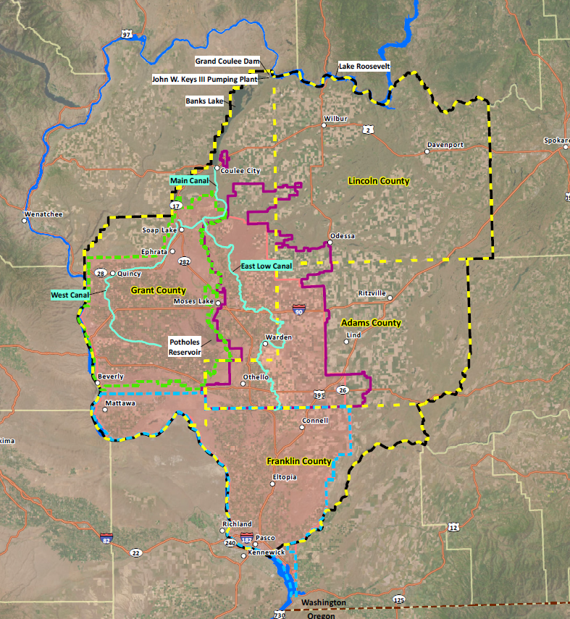
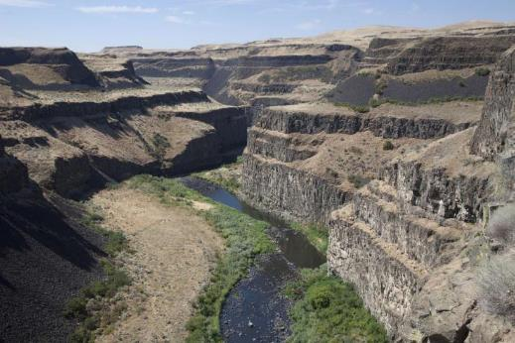
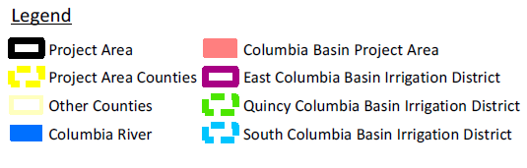
Water Availability
Surface water: Columbia Basin Project
  1943 – 1970s
  incomplete
Groundwater: Basalt Aquifer
Notes:
Columbia Basin Project
Groundwater withdrawals were authorized with the intent that they would later be swapped for canal water from the Project, however, the Project stalled out in the 1970s and groundwater mining has degraded the groundwater resource

Slide 8
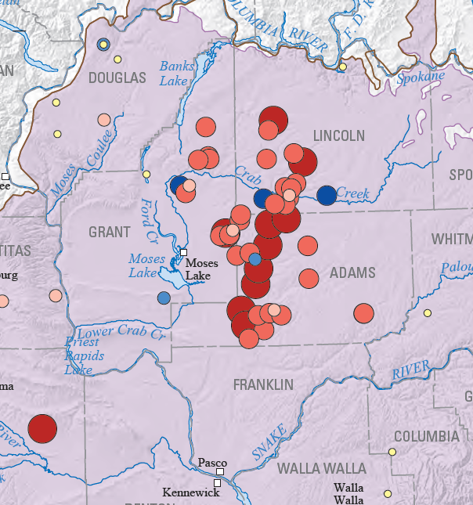
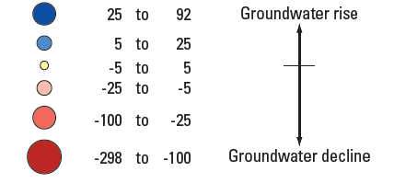
Groundwater Declines
Groundwater Declines
Grande Ronde 1984-2009
Declining groundwater levels
Water shortages
Drinking water dependence on groundwater
Irrigation dependence on groundwater
Notes:
Declining Groundwater Levels
We are seeing increased water demand and specifically during drought we are seeing even more utilization of groundwater.
Water Shortages
Lower groundwater availability contributes directly to water shortages, affecting both municipal supplies and agricultural needs.
Drinking Water Dependence on Groundwater
Many communities rely heavily on groundwater as their primary source of drinking water, remember 80% of the population depends on groundwater for their drinking water. As levels drop, the risk of water scarcity and quality issues increases.
Irrigation Dependence on Groundwater
Ground water dependent irrigators typically utilize more water during drought, increasing groundwater declines.
On the right side of the slide, you’ll see a visual showing groundwater declines in the Grande Ronde aquifer, tracked from 1984 to 2009. The larger red dots indicate the areas with the greatest declines (100 ft to almost 300 ft)—several of which fall within the FLAG county boundaries.

Slide 9
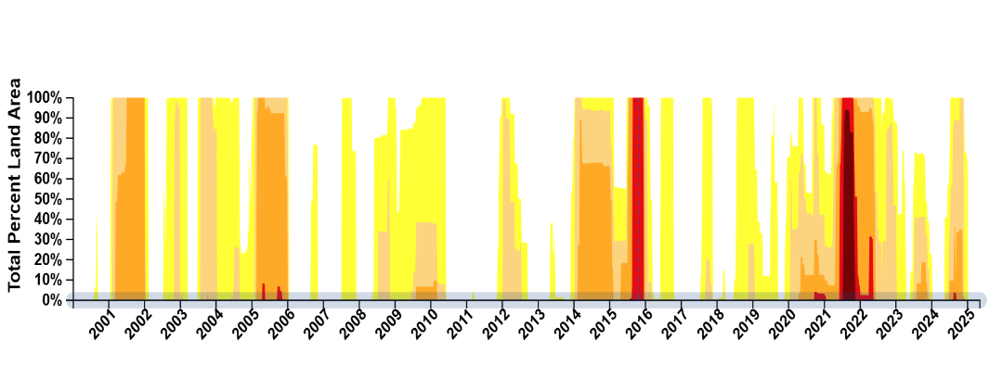
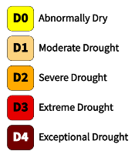
Drought History
Exceptional Drought – 2015 & 2021
    Widespread crop + pasture losses
    Exceptional fire risk
    Water availability emergencies
Future of Drought
  More common in the future
2021
Notes:
Historical Drought Events
Our region has experienced several major droughts in recent years, with 2015 and 2021 standing out as two of the most severe- highlighting exceptional drought. These events give us a clear picture of how our communities are impacted under extreme conditions. The bottom chart highlights WA state drought occurrences from 2001 through 2025, while the map on the upper right shows the FLAG counties in exceptional drought conditions during 2021.
Agricultural Impacts
During drought, reduced water availability led to yield losses for several crops. This has lasting economic and food supply consequences for the economy of the region.
Wildfire risks
Many of our communities have experienced significant losses from wildfires during drought periods. When drought conditions combine with high winds and lightning, the risk of wildfire increases substantially.
Drinking Water Impacts
Some areas also experienced concerns with drinking water supply, highlighting the vulnerabilities of smaller systems and groundwater-dependent communities.
Looking Ahead
Climate projections suggest that droughts like these will likely become more common in the future, making proactive planning and preparedness essential.

Slide 10
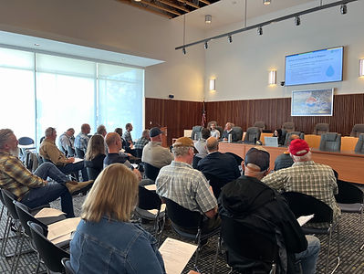
Columbia Basin Sustainable Water Coalition
Water purveyor work group
Mission:
  “Address potable groundwater supply issues by creating locally driven recommendations that influence water management and policy that will direct resources to create sustainable water solutions.”
Add text/images on formation of the Coalition… this created the network for purveyors, conservation districts, municipalities, - that network exists … next step is bringing in community partners from overburdened populations (be sensitive to how we use this language)
Include OGWRP, example of another coalition… lead by East Columbia Basin Irrigation district (?)
GWMA?
Notes:
Coalition:
Local governments
Water purveyors
Conservation Districts
Irrigation Districts
Legislators
Farmers
Farm workers
Community members
Tribes

Slide 11
Columbia Basin Sustainable Water Coalition - History
Mid-Columbia Basin Data Collection and Technical Assistance Project
- Goal: Raise awareness about declining groundwater
- Who? DOH Office of Drinking Water
DOH Office of Drinking Water + Commerce Small Communities Initiatives begin working together on recommendation to address groundwater declines & water insecurity
Mid-Columbia Resiliency Coordination Final Report
Recommendations: water level reporting, long-term monitoring, support for CBSWC, state + federal agency coordination, regionalization
WaterSmart grant (Bureau of Reclamation) for CBSWC facilitation and groundwater level monitoring
- Columbia Basin Project (1943 – 1970s)
- Columbia Basin Groundwater Management Area (1998 – 2014)
1943 - 2014
2016
2017
2019
2022
Notes:
Columbia Basin Project – storage and distribution of Columbia River water for irrigation (dams and canals)
Columbia Basin GWMA – Formed by Ecology to address nitrate in groundwater and groundwater declines the mid-Columbia – lots of wonderful technical work completed: detailed geologic structure mapping of the basalt aquifers
DOH + Commerce recognized the need to get communities effected by gw declines together, - the vision was to provide planning assistance to municipalities & small water systems affected by declining groundwater so that those communities could come up with locally driven recommendations for water management and collectively voice their concerns to state and federal policy makers in order to bring resources to the area.

Slide 12
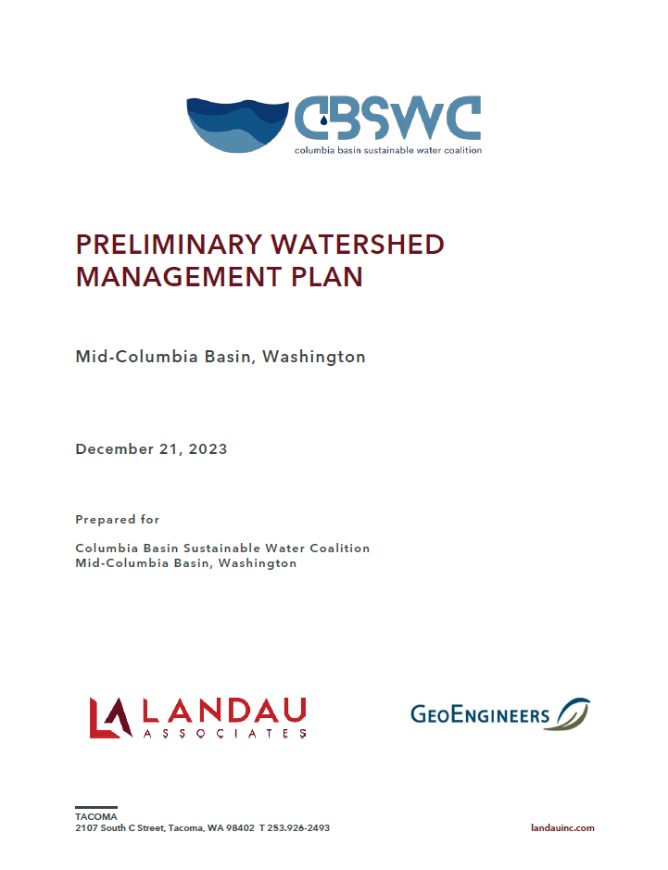
Columbia Basin Sustainable Water Coalition
Coalition project recommendations:
  Exchange groundwater for surface water
    Odessa Groundwater Replacement Program (OGWRP)
    Columbia Basin Project Completion
  Conservation
  Aquifer recharge
Successes:
  OGWRP
  WaterSmart Grant: Groundwater web app (Bureau of Reclamation)
  Drought Planning Grant: (Ecology)
Notes:
Extend canal network so irrigation water comes from the Project rather than pumped groundwater
Use less water
Add water back to the aquifer

Slide 13
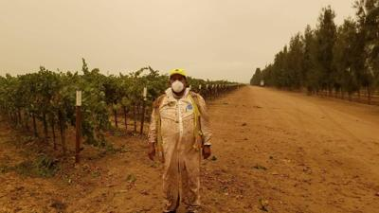
Broadening the Coalition
“…community resilience to drought is unevenly distributed across the state, with low-income, tribal, and overburdened communities facing water security challenges earliest, and with greater frequency and severity.”
(Ecology 2023)
Community Engagement Plan finalized at the end of 2025
Notes:
The grant directive emphasized the importance of participation and direct involvement of existing stakeholders as well as vulnerable populations who may or may not have been involved in previous planning efforts.
Vulnerable Populations - people that are likely to be at a higher risk than normal for poor health outcomes in response to drought and drought related harms

Slide 14
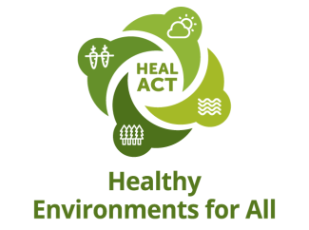
Community Engagement Plan
1. Preparing for Engagement
  Determine the purpose of engagement
  Principles of engagement:
    do your research, value other’s time, be transparent, etc.
  Identify overburdened communities
  Select outreach strategies – tailor approach to each partner
2. Engaging with Community
3. Reflections and Follow up
  Incorporate feedback
  Reflect – How did it go?
  Maintain community relationships
Notes:
The grant directive emphasized the importance of participation and direct involvement of existing stakeholders as well as vulnerable populations who may or may not have been involved in previous planning efforts.
Vulnerable Populations - people that are likely to be at a higher risk than normal for poor health outcomes in response to drought and drought related harms

Slide 15
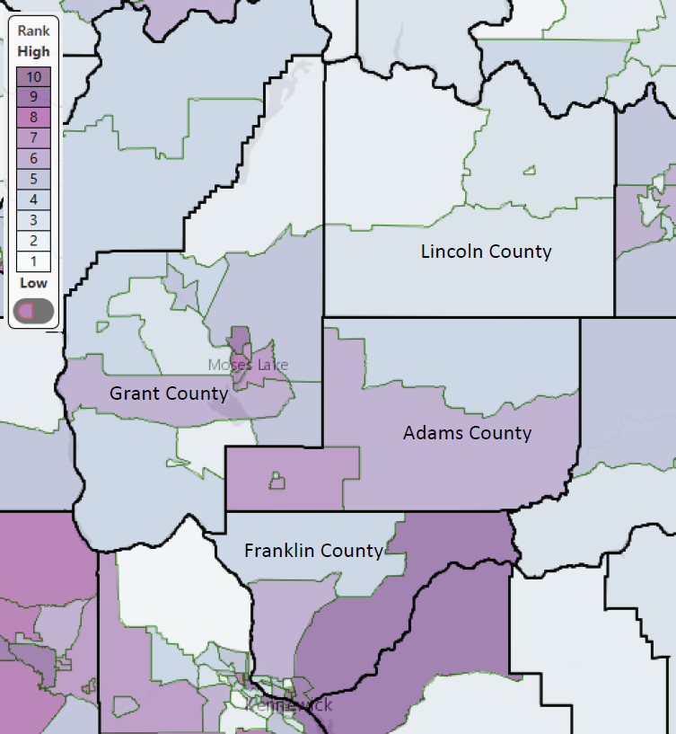
Overburdened Communities
Environmental Health Disparities Map (WA DOH)
A population of people that is likely to be at a higher risk than normal for poor health outcomes in response to drought
Tools Used
  HEAL Act worksheet to identify overburdened communities
    DOH Environmental Health Disparities Map
    Census data, ex: query for Speaks English less than “very well”
Notes:
Notes:
- Environmental Health Disparities are the increasing combination of factors (social, medical, climate, and environmental) that create inequities in health, which cause more sickness, disease, pollution, and other problems to Washington communities with more economic need.
- HEAL Act – Healthy Environment for All – pass in 2021 to address environmental and health disparities in Washington State
Vulnerable communities are groups of people who face a higher risk of poor health outcomes in response to drought and drought related harms.
These vulnerabilities often relate to socioeconomic attributes, including:
Low-income households, who may have limited resources to adapt or recover.
Racial and ethnic minorities, who often face systemic barriers to health and emergency support.
Residents with language barriers, which can impact access to information, alerts, and assistance programs.
To identify and assess these communities, we used several data tools:
The Washington Environmental Health Disparities Map (EHD Map), which shows health risks across geographic areas.
EJScreen, the EPA’s environmental justice mapping tool, which combines environmental and demographic indicators.
The Climate & Economic Justice Screening Tool, developed by the Council on Environmental Quality, which highlights communities facing overlapping social and environmental burdens.
Recognizing these communities allows us to focus outreach, allocate resources, and ensure equitable support during drought planning and response.

Slide 16
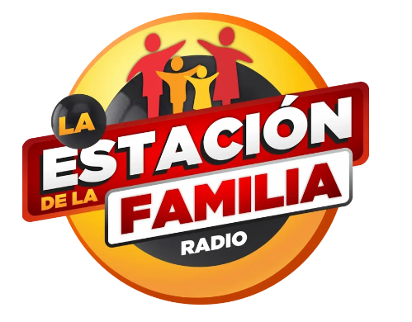
Engagement Goals & Strategies
Goal: Receive input & feedback on…
  drought risks/vulnerabilities
  drought mitigation project ideas
  potential unintended consequences
Outreach Strategy Example: Spanish speaking farm workers
  Needs example: language access
  Barrier example: fear of immigration enforcement
  Strategies: provide outreach materials in Spanish, partner with trusted community members, use existing media (outreach via local Spanish language radio)
Notes:
Example - dams

Slide 17
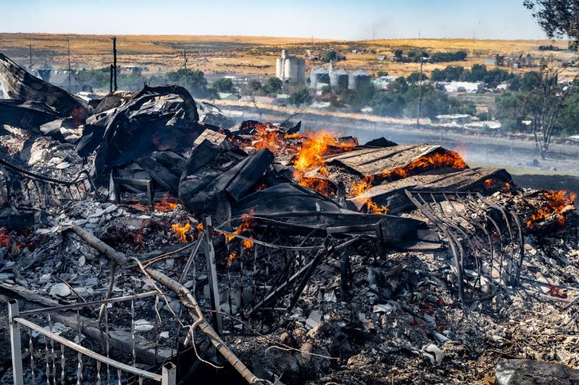
Build on Existing Work - Known Drought Risks
2022 City of Lind Fire
Economic disruption
  2015 drought - $700 million
  losses in agriculture
Damage to natural resources
  Fish die-offs
Public health effects
  Reduction in air quality
Groundwater declines (driven by increased demand)
  Risks to drinking water supply
Management Risks
  Limited resources for short-term response + long-term planning & adaptation
Notes:
Drought can have widespread consequences that impact both our communities and the surrounding environment. Let's break down the primary areas of concern:
Economic Impacts: Drought conditions can severely disrupt local economies, especially in sectors that depend on steady water supply. Agriculture may face reduced crop yields or livestock losses, industries might need to scale back operations, small businesses and recreational activities also suffer.
Environmental Pressures: Rivers, wetlands, and riparian habitats may shrink or dry up, harming fish populations and wildlife that rely on these water sources.
Public Health Risks: According to the Center for Disease Control (CDC) drought conditions can affect water quality, heat related illnesses/death, air quality, vector borne diseases (West Nile virus), water borne illness (E-coli) as well as mental health. Groundwater Stress: As I mentioned at the beginning of the presentation, many people rely on groundwater for their primary water supply. During drought, demand for this water increases, leading to over-pumping of wells and aquifers. This can result in long-term declines in water tables, increased pumping costs, and potential well failures.
Management & Planning Challenges: Finally, drought places added pressure on water managers and policymakers. Limited resources must be distributed carefully across multiple needs. This requires coordination, long-term planning, and often, difficult tradeoffs such as increased rates to help reduce consumption of water by its users.

Slide 18

Drought Mitigation Projects – Existing & Aspirational
Infrastructure Projects
  CBP Completion; OGWRP
  New Source Treatment and Regional Distribution
  Water Conservation
  ASR
  Lake Roosevelt Incremental Storage Release Program
  Regionalization (water system consolidation projects)
Water Resource Management Tools
  Groundwater Monitoring
  Groundwater Modeling
  Technical Assistance
  Water Right Curtailment & Enforcement Actions
  Expedited Water Right Permitting & Leasing of Water Rights
  Forecast future water supplies and demand
Funding
  Funding Programs
  Budget sustainability
Water Resource Planning
  Integrated water resource management planning programs
  CBSWC
  Water Management
  Bureau of Reclamation Basin Study
  Coordinated Water System Planning
  Local, State, and Federal Agency Coordination
  Partnership & Public Outreach
  Agriculture and water systems specific vulnerabilities and actions
Notes:
Does not address drought directly
CBSWC identified several projects, tools, and planning alternatives for sustainable water management in the planning area
Microsoft Word - CBSWC Preliminary Watershed Management Plan_2023_12_21_2023

Slide 19
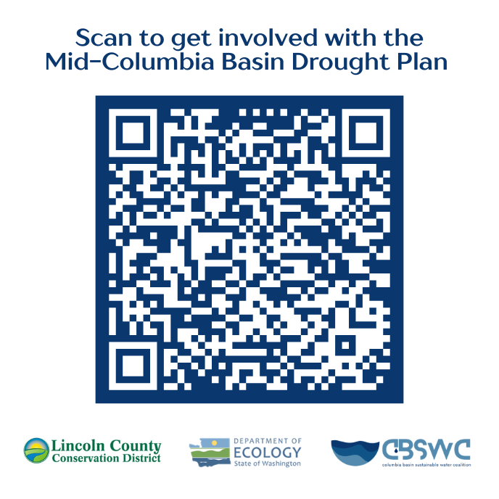

Q&A
Thank you!

